Slide 1
Can we predict the winner of
Super Bowl LIII?
Michael Ahn, Salil Deshpande, Carmen Robinson, Sam Timura

Slide 2
The Inspiration
FiveThirtyEight

Slide 3

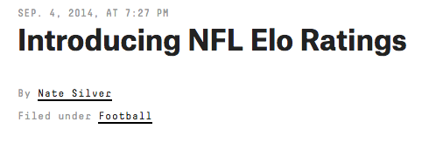
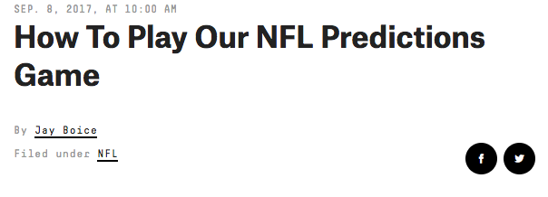
FiveThirtyEight’s Elo Model

Slide 4
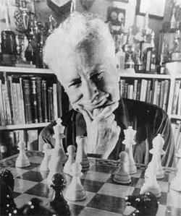
What is Elo?
Method for calculating relative skill of players in head to head matchups.
Probability of winning is not measured absolutely but is inferred from past performance.
Made for chess but good for football too.
Dependent on K parameter and logistic regression.

Slide 5
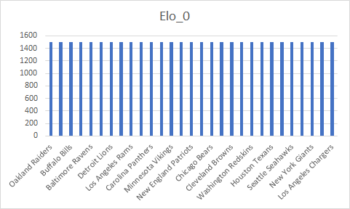
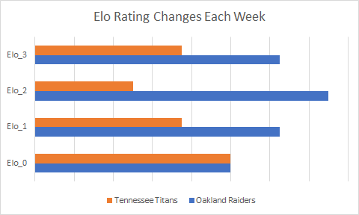
What is Elo?
E_A = 1/(1 + Elo_0**((eloB - eloA)/ELO_DIF)
eloA = elos[home][WEEK][YEAR-START_YEAR] + HOME_ADV
MOV = LN(ABS(PD)+1) * (2.2/((ELOW-ELOL)*.001+2.2))

Slide 6


2018-2019 Season Predictions
Dolphins Buccaneers Chargers Jets
Titans Rams Bears Jaguars 49ers
Browns
Math is on their side
Likely Losers
Eagles
Steelers
Colts
Patriots
Chiefs

Slide 7
The Data & Wrangling
FiveThirtyEight’s historical NFL data 1920-2017
NFL.com 2018-2019 schedule
….onto the Jupyter Notebook

Slide 8
Model Building: Feature Selection
Madden rates each player on 42 features
Retained features tied to either on-field performance or combine results
Strength rating from NFL Combine bench press workout
Tackle rating from season statistics
Eliminated arbitrary features
Finesse Moves
Power Moves

Slide 9
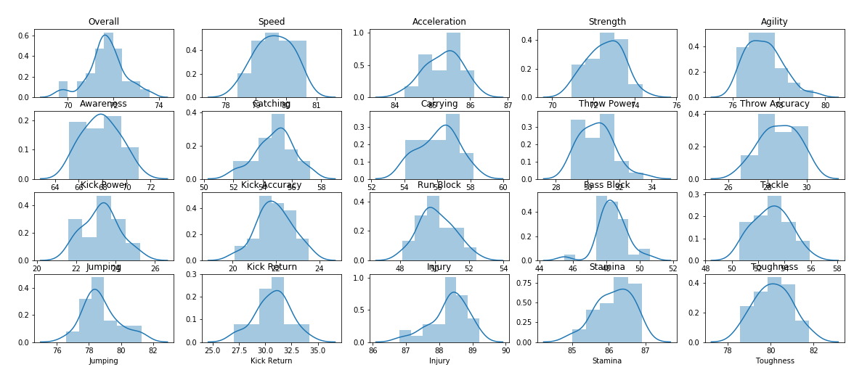
Model Building: Feature Engineering
Features tend to follow normal distributions = good data to model

Slide 10
Model Building: Approach
Create numerical classes
5 = Miss playoffs
4 = Make playoffs but lose before NFC/AFC Conference Championship
3 = Lose in Conference Championship
2 = Lose in Super Bowl
1 = Win Super Bowl
Produces class imbalance problem
Could create problems for machine learning models that rely on probability

Slide 11
Model Building: Machine Learning Algorithms
Train and test different machine learning algorithms
RandomForest Classifier
Support Vector Classification
k-Nearest Neighbors
Gaussian Naive Bayes
Perceptron
Create a model based on the best algorithms

Slide 12
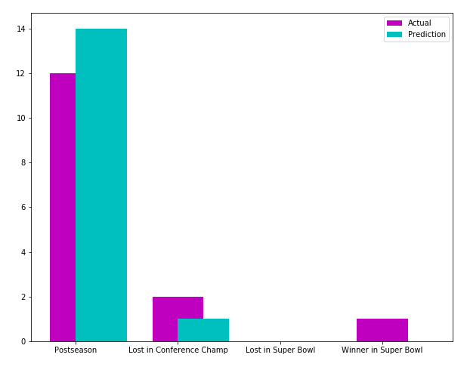
Model Building: RandomForest Classifier
Utilizes decision trees, in which an input is entered at the top and as it traverses down the tree the data gets bucketed into smaller sets
Did a good job of capturing teams going to the postseason in the testing data
Add to final model

Slide 13
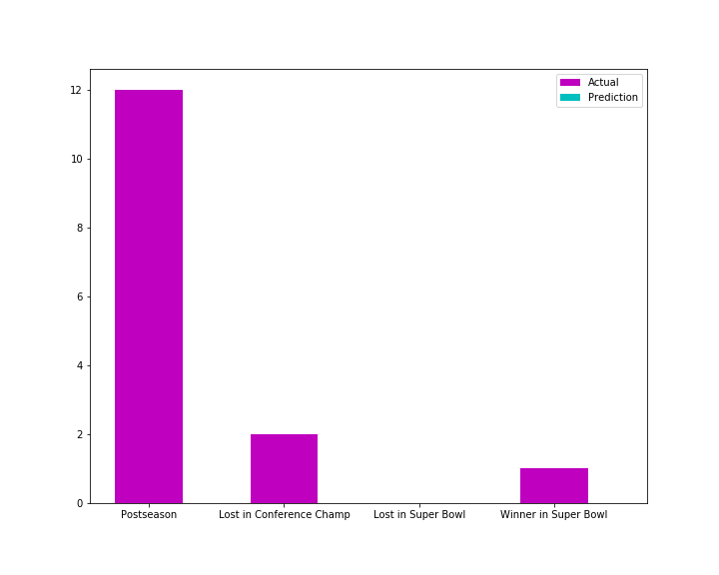
Model Building: Support Vector Classification
Process of separating classes with a hyper-plane
Did a poor job of predicting teams going to the postseason in the testing set
Do not add to final model

Slide 14
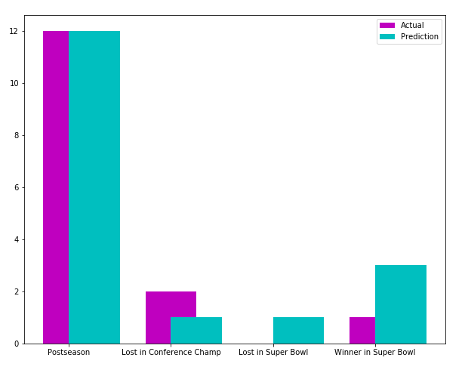
Model Building: k-Nearest Neighbors
Classification by finding the most similar data points in the training data
Did the best job of capturing teams going to the postseason in the testing data
Add to final model

Slide 15
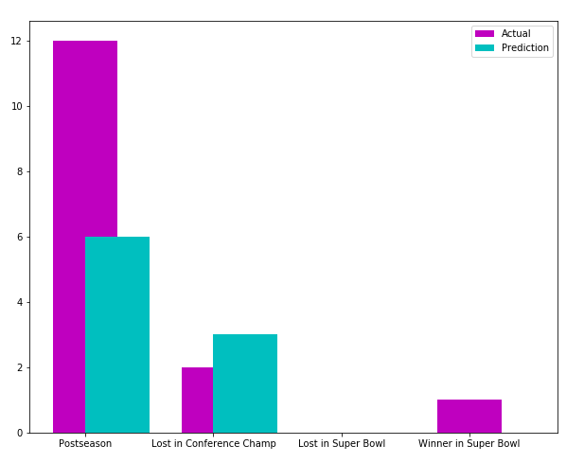
Model Building: Gaussian Naive Bayes
Probabilistic classifiers based on applying Bayes’ theorem with a strong independence assumptions between features
Did a good job of capturing teams going to the postseason in the testing data
Add to final model

Slide 16
Model Building: Perceptron
Linear classifier (much like a normal linear regression)
Did a poor job of predicting teams going to the postseason in the testing set
Do not add to final model

Slide 17
Final Model
30% RandomForest
30% Gaussian Naive Bayes
40% k-Nearest Neighbor
Ran 1,000 “simulations”, and here are the results...

Slide 18
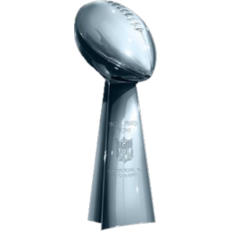
2018-2019 NFL Playoffs
Wild Card Round
Wild Card Round
Rams
Divisional Round
Divisional Round
Titans
Saints
Titans
Saints
NFC Championship
AFC Championship
Steelers
Eagles
Patriots
Eagles
Patriots
SUPER BOWL LIII
Eagles
Raiders
Lions
Raiders
WINNER
Eagles
Lions
Raiders
Falcons
Jaguars
Cowboys
Jaguars
Cowboys
Chiefs
Notes:
© Copyright Showeet.com – Creative & Free PowerPoint Templates

Slide 19
Eagles Repeat
SUPER BOWL LIII
Eagles
Raiders
WINNER
Eagles

Slide 20
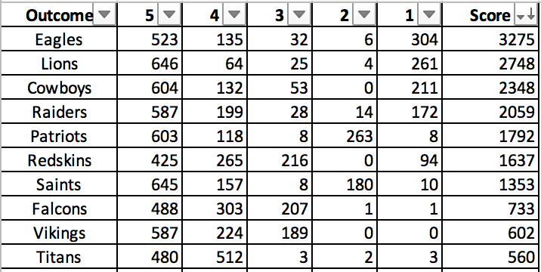
Model Surprises
My model loves the Detroit Lions
My model thinks the Raiders are the best team in the AFC
The Redskins are the sixth best team?

Slide 21
Thank You
Questions?

